Slide 1


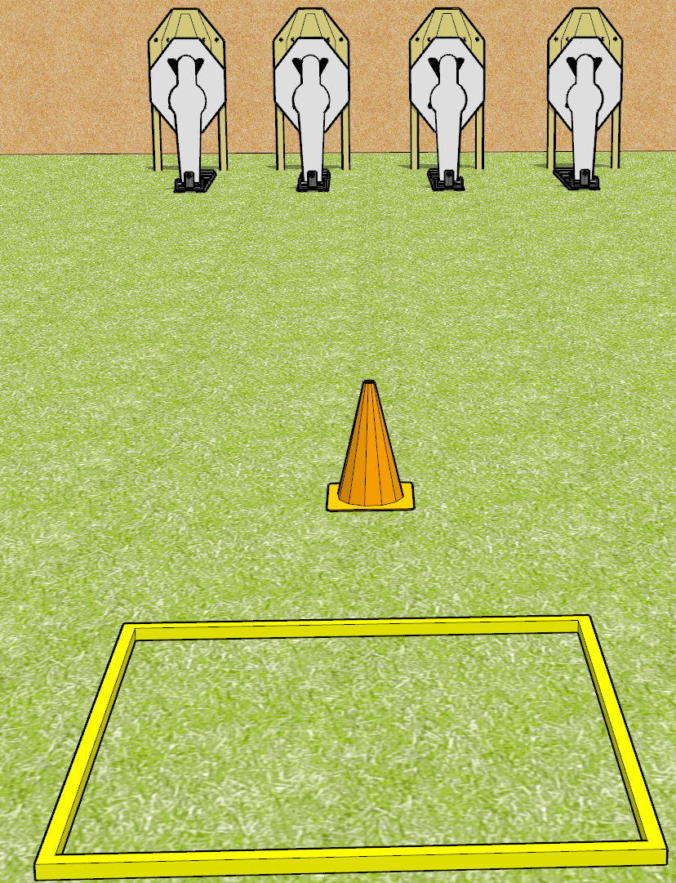
 | Dothan Gun Club – USPSA Match Blaze It Course Designer : Drew Coleman
Round Count 8 rounds 4 IPSC 4 mini poppers
Equipment List 1 shooting box

Slide 2
Blaze It
Written Stage Briefing
Blaze it is an 8 round, 40 point, Comstock speed shoot. There are 4 IPSC targets and 4 mini poppers. The best hit on paper will score, and steel must fall to score.
Handgun start position is in shooting box, facing uprange, wrists above shoulders. Handgun is loaded and holstered.
PCC start position is in shooting box, muzzle pointed at cone. Loaded carbine is held with both hands, safety on.
On start signal, engage targets as they become available from within the shooting area.

Slide 3
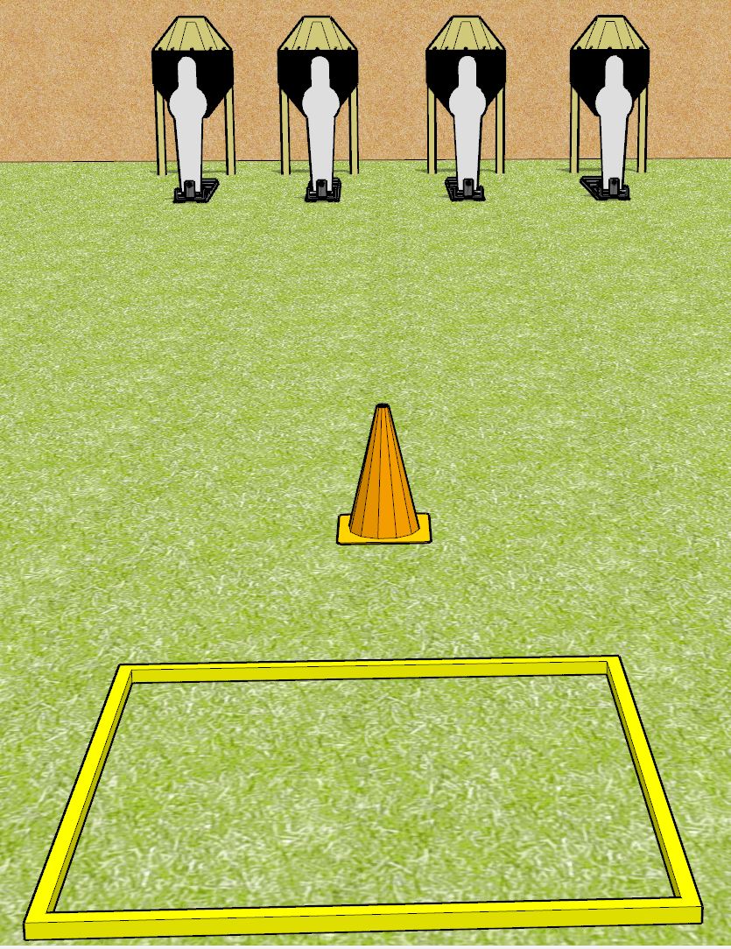
 | Dothan Gun Club – USPSA Match Blaze It Course Designer : Drew Coleman
Round Count 8 rounds 4 IPSC 4 mini poppers
Equipment List 1 shooting box

